Slide 1
Chapter 25 Sorting

Slide 2
Objectives
To study and analyze time efficiency of various sorting algorithms (§§25.2–25.7).
To design, implement, and analyze bubble sort (§25.2).
To sort an array using the selection sort (§6.10.1)
To sort an array using the insertion sort algorithm (§6.10.2).
To design, implement, and analyze merge sort (§25.3).
To design, implement, and analyze quick sort (§25.4).
To design and implement a heap (§25.5).
To design, implement, and analyze heap sort (§25.5).
To design, implement, and analyze external sort for large data in a file (§25.7).

Slide 3
why study sorting?
Sorting is a classic subject in computer science. There are three reasons for studying sorting algorithms.
  First, sorting algorithms illustrate many creative approaches to problem solving and these approaches can be applied to solve other problems.
  Second, sorting algorithms are good for practicing fundamental programming techniques using selection statements, loops, methods, and arrays.
  Third, sorting algorithms are excellent examples to demonstrate algorithm performance.

Slide 4
what data to sort?
The data to be sorted might be integers, doubles, characters, or objects. §6.8, “Sorting Arrays,” presented selection sort and insertion sort for numeric values. The selection sort algorithm was extended to sort an array of objects in §11.5.7, “Example: Sorting an Array of Objects.” The Java API contains several overloaded sort methods for sorting primitive type values and objects in the java.util.Arrays and java.util.Collections class. For simplicity, this section assumes:
data to be sorted are integers,
data are sorted in ascending order, and
data are stored in an array. The programs can be easily modified to sort other types of data, to sort in descending order, or to sort data in an ArrayList or a LinkedList.

Slide 5
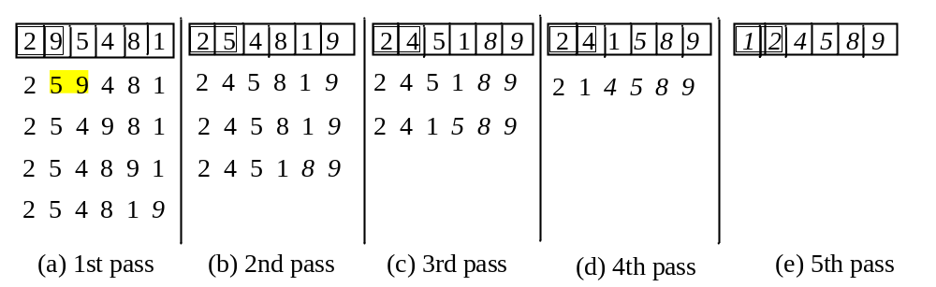
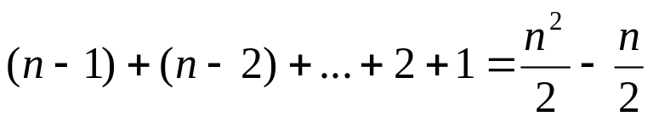
Bubble Sort
Bubble sort time: O(n²)
BubbleSort
Run

Slide 6
Bubble Sort Animation
http://www.cs.armstrong.edu/liang/animation/BubbleSortAnimation.html

Slide 7
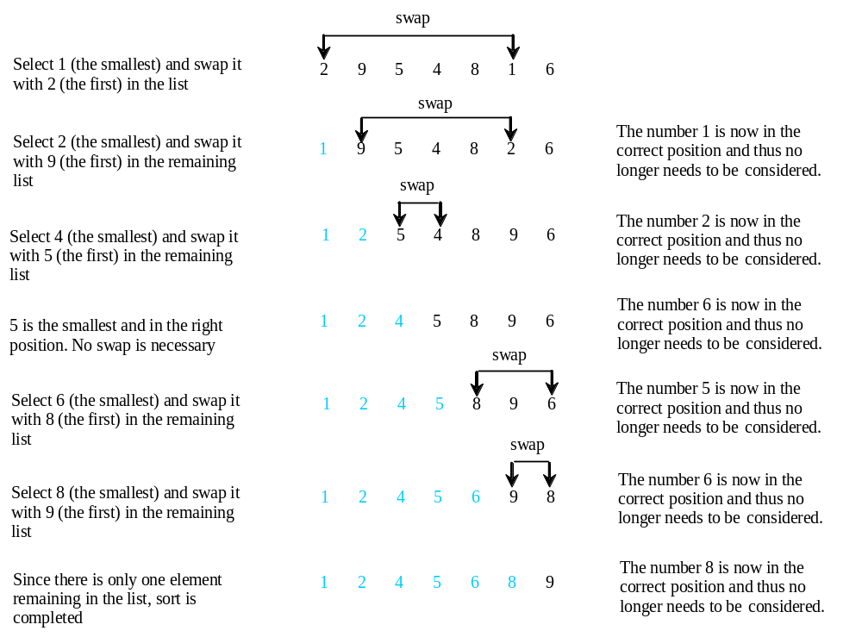
Selection Sort
Selection sort finds the largest number in the list and places it last. It then finds the largest number remaining and places it next to last, and so on until the list contains only a single number. Figure 6.17 shows how to sort the list {2, 9, 5, 4, 8, 1, 6} using selection sort.

Slide 8
From Idea to Solution
for (int i = 0; i < list.length; i++)
{
select the smallest element in list[i..listSize-1];
swap the smallest with list[i], if necessary;
// list[i] is in its correct position.
// The next iteration apply on list[i..listSize-1]
}
list[0] list[1] list[2] list[3] ... list[10]
list[0] list[1] list[2] list[3] ... list[10]
list[0] list[1] list[2] list[3] ... list[10]
list[0] list[1] list[2] list[3] ... list[10]
list[0] list[1] list[2] list[3] ... list[10]
...
list[0] list[1] list[2] list[3] ... list[10]

Slide 9
Expand
for (int i = 0; i < listSize; i++)
{
select the smallest element in list[i..listSize-1];
swap the smallest with list[i], if necessary;
// list[i] is in its correct position.
// The next iteration apply on list[i..listSize-1]
}
double currentMin = list[i];
int currentMinIndex = i;
for (int j = i; j < list.length; j++) {
if (currentMin > list[j]) {
currentMin = list[j];
currentMinIndex = j;
}
}

Slide 10
Expand
for (int i = 0; i < listSize; i++)
{
select the smallest element in list[i..listSize-1];
swap the smallest with list[i], if necessary;
// list[i] is in its correct position.
// The next iteration apply on list[i..listSize-1]
}
double currentMin = list[i];
int currentMinIndex = i;
for (int j = i; j < list.length; j++) {
if (currentMin > list[j]) {
currentMin = list[j];
currentMinIndex = j;
}
}

Slide 11
Expand
for (int i = 0; i < listSize; i++)
{
select the smallest element in list[i..listSize-1];
swap the smallest with list[i], if necessary;
// list[i] is in its correct position.
// The next iteration apply on list[i..listSize-1]
}
if (currentMinIndex != i) {
list[currentMinIndex] = list[i];
list[i] = currentMin;
}

Slide 12
Wrap it in a Method
/** The method for sorting the numbers */
public static void selectionSort(double[] list) {
for (int i = 0; i < list.length; i++) {
// Find the minimum in the list[i..list.length-1]
double currentMin = list[i];
int currentMinIndex = i;
for (int j = i + 1; j < list.length; j++) {
if (currentMin > list[j]) {
currentMin = list[j];
currentMinIndex = j;
}
}
// Swap list[i] with list[currentMinIndex] if necessary;
if (currentMinIndex != i) {
list[currentMinIndex] = list[i];
list[i] = currentMin;
}
}
}
Invoke it
selectionSort(yourList)

Slide 13
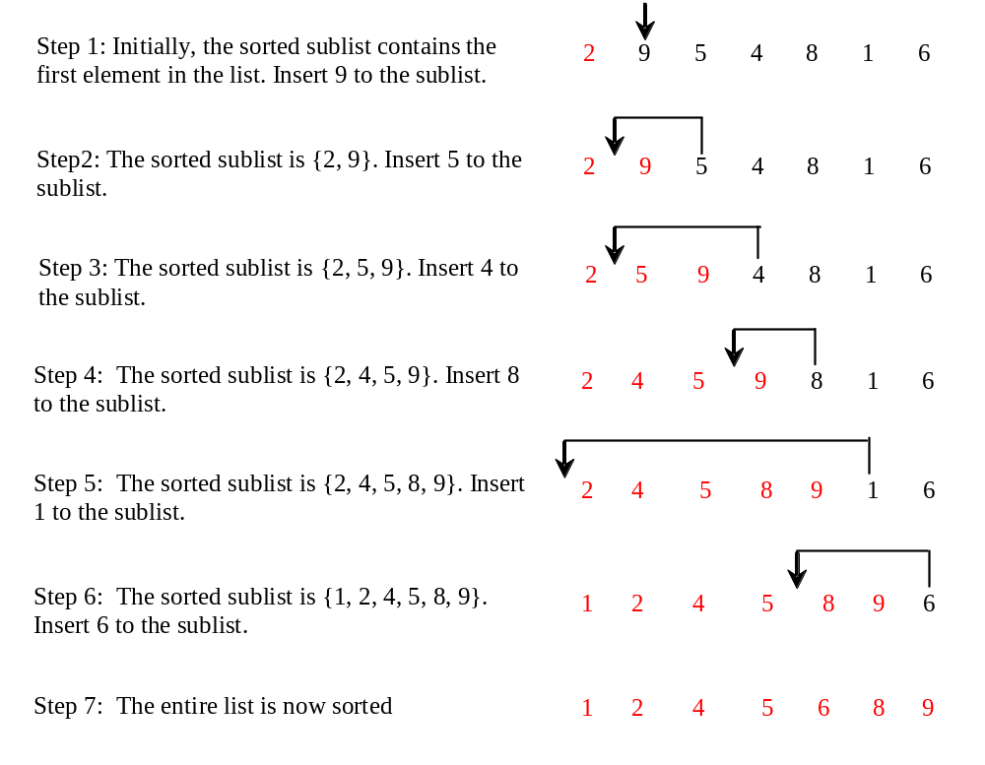
Insertion Sort
int[] myList = {2, 9, 5, 4, 8, 1, 6}; // Unsorted
The insertion sort algorithm sorts a list of values by repeatedly inserting an unsorted element into a sorted sublist until the whole list is sorted.

Slide 14
Insertion Sort
animation
int[] myList = {2, 9, 5, 4, 8, 1, 6}; // Unsorted
2 | 9 | 5 | 4 | 8 | 1 | 6
2 | 9 | 5 | 4 | 8 | 1 | 6
2 | 5 | 9 | 4 | 8 | 1 | 6
2 | 4 | 5 | 9 | 8 | 1 | 6
2 | 4 | 5 | 8 | 9 | 1 | 6
1 | 2 | 4 | 5 | 8 | 9 | 6
1 | 2 | 4 | 5 | 6 | 8 | 9

Slide 15
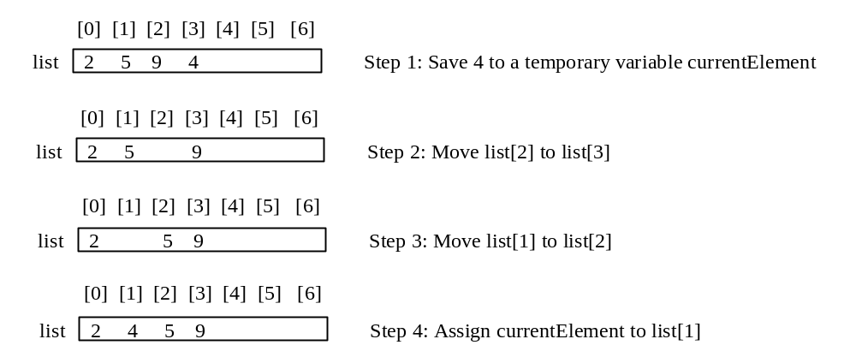
How to Insert?
The insertion sort algorithm sorts a list of values by repeatedly inserting an unsorted element into a sorted sublist until the whole list is sorted.

Slide 16
From Idea to Solution
for (int i = 1; 1; i < list,length; i++) {
insert list[i] into a sorted sublist list[0..i-1] so that
list[0..i] is sorted
}
list[0]
list[0] list[1]
list[0] list[1] list[2]
list[0] list[1] list[2] list[3]
list[0] list[1] list[2] list[3] ...
InsertSort

Slide 17
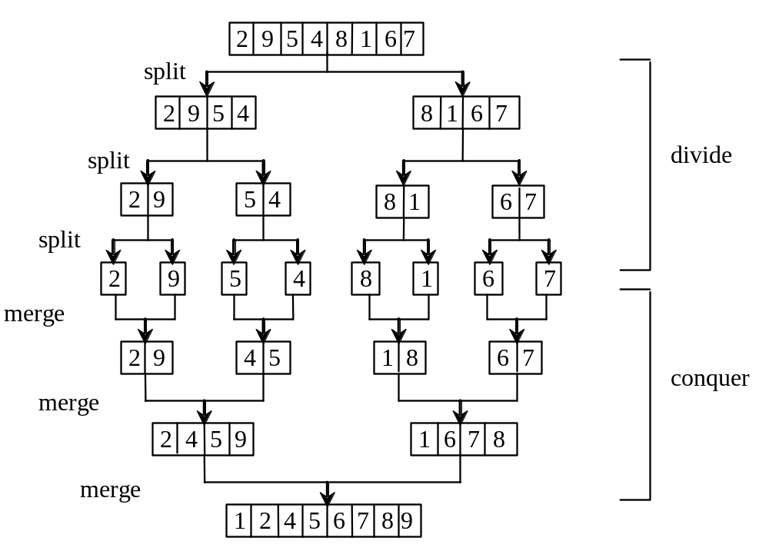
Merge Sort
MergeSort
Run

Slide 18
Merge Sort
mergeSort(list):
firstHalf = mergeSort(firstHalf);
secondHalf = mergeSort(secondHalf);
list = merge(firstHalf, secondHalf);

Slide 19
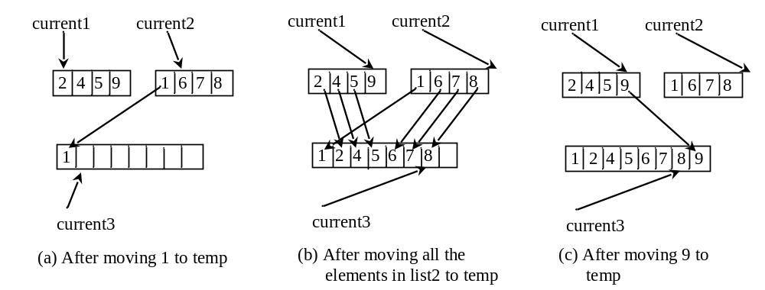
Merge Two Sorted Lists

Slide 20
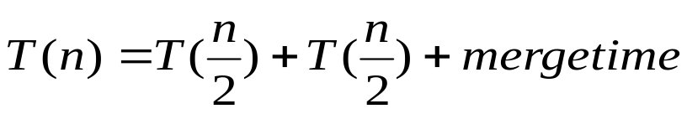
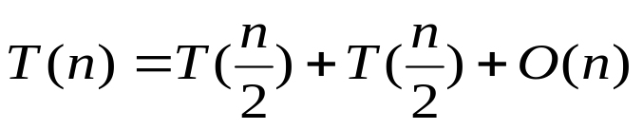
Merge Sort Time
Let T(n) denote the time required for sorting an array of n elements using merge sort. Without loss of generality, assume n is a power of 2. The merge sort algorithm splits the array into two subarrays, sorts the subarrays using the same algorithm recursively, and then merges the subarrays. So,

Slide 21
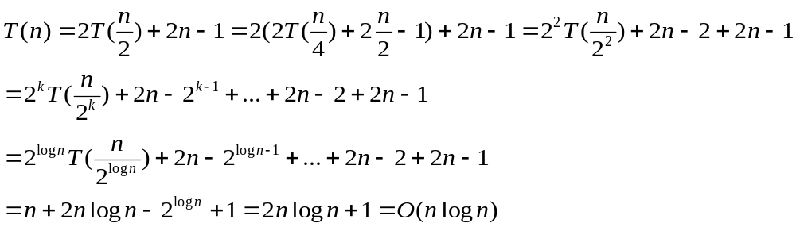
Merge Sort Time
The first T(n/2) is the time for sorting the first half of the array and the second T(n/2) is the time for sorting the second half. To merge two subarrays, it takes at most n-1 comparisons to compare the elements from the two subarrays and n moves to move elements to the temporary array. So, the total time is 2n-1. Therefore,

Slide 22
Quick Sort
Quick sort, developed by C. A. R. Hoare (1962), works as follows: The algorithm selects an element, called the pivot, in the array. Divide the array into two parts such that all the elements in the first part are less than or equal to the pivot and all the elements in the second part are greater than the pivot. Recursively apply the quick sort algorithm to the first part and then the second part.

Slide 23
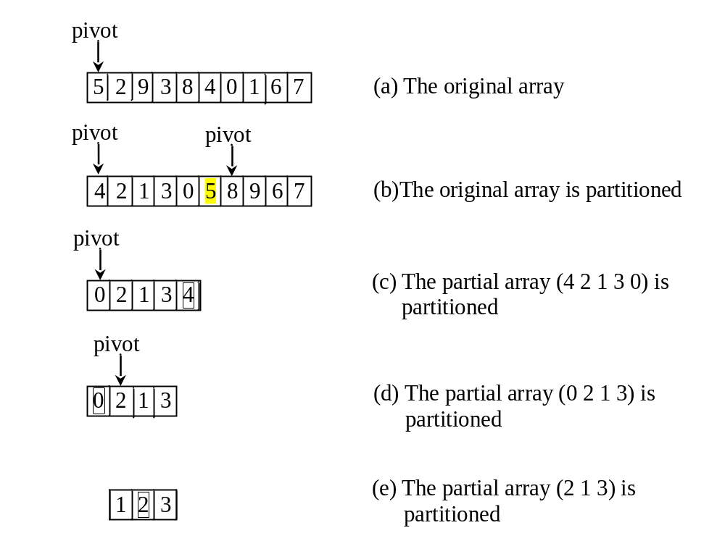
Quick Sort

Slide 24
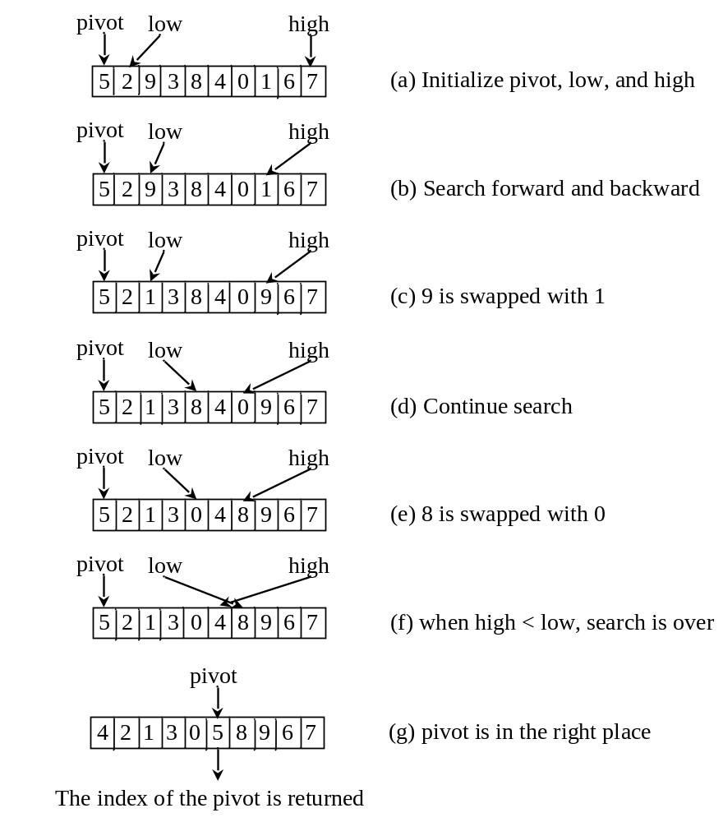
Partition
QuickSort
Run

Slide 25
Quick Sort Time
To partition an array of n elements, it takes n-1 comparisons and n moves in the worst case. So, the time required for partition is O(n).

Slide 26


Worst-Case Time
In the worst case, each time the pivot divides the array into one big subarray with the other empty. The size of the big subarray is one less than the one before divided. The algorithm requires time:

Slide 27
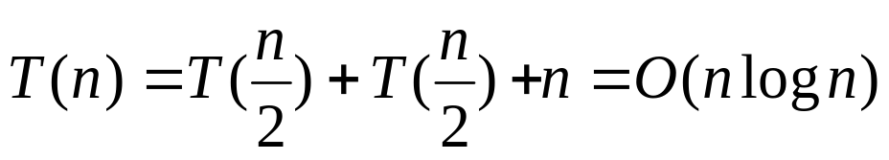
Best-Case Time
In the best case, each time the pivot divides the array into two parts of about the same size. Let T(n) denote the time required for sorting an array of elements using quick sort. So,

Slide 28
Average-Case Time
On the average, each time the pivot will not divide the array into two parts of the same size nor one empty part. Statistically, the sizes of the two parts are very close. So the average time is O(nlogn). The exact average-case analysis is beyond the scope of this book.

Slide 29
Heap
Heap is a useful data structure for designing efficient sorting algorithms and priority queues. A heap is a binary tree with the following properties:
It is a complete binary tree.
Each node is greater than or equal to any of its children.

Slide 30
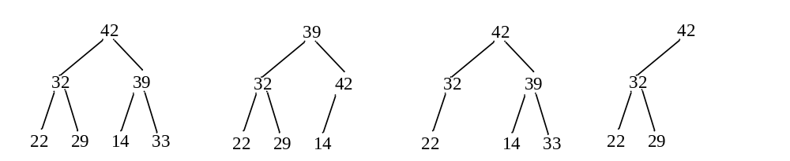
Complete Binary Tree
A binary tree is complete if every level of the tree is full except that the last level may not be full and all the leaves on the last level are placed left-most. For example, in the following figure, the binary trees in (a) and (b) are complete, but the binary trees in (c) and (d) are not complete. Further, the binary tree in (a) is a heap, but the binary tree in (b) is not a heap, because the root (39) is less than its right child (42).

Slide 31
See How a Heap Works
http://www.cs.armstrong.edu/liang/animation/HeapAnimation.html

Slide 32
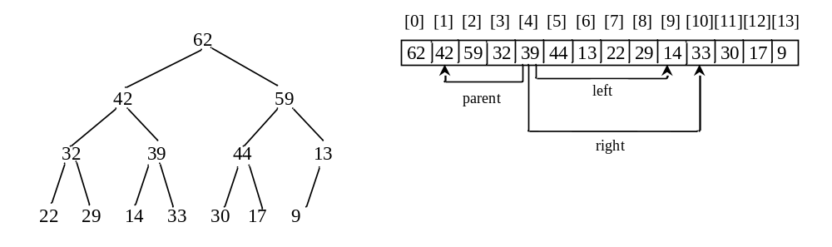
Representing a Heap
For a node at position i, its left child is at position 2i+1 and its right child is at position 2i+2, and its parent is (i-1)/2. For example, the node for element 39 is at position 4, so its left child (element 14) is at 9 (2*4+1), its right child (element 33) is at 10 (2*4+2), and its parent (element 42) is at 1 ((4-1)/2).

Slide 33
Adding a New Node
To add a new node to the heap, first add it to the end of the heap and then rebuild the tree as follows:
Let the last node be the current node;
While (the current node has parent and the current node is greater than its parent) {
Swap the current node with its parent;
Now the current node is one level up;
}

Slide 34
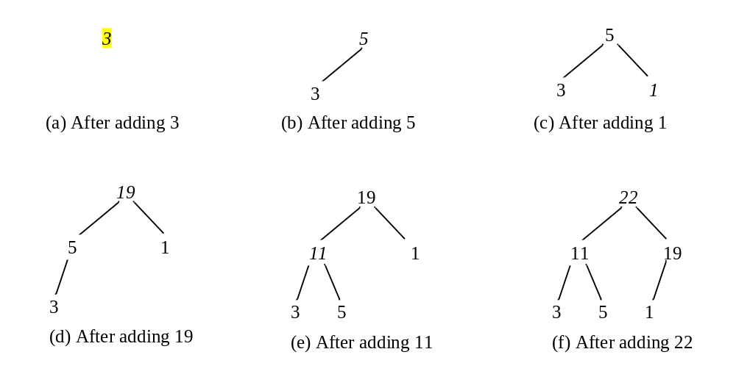
Adding Elements to the Heap
Adding 3, 5, 1, 19, 11, and 22 to a heap, initially empty

Slide 35
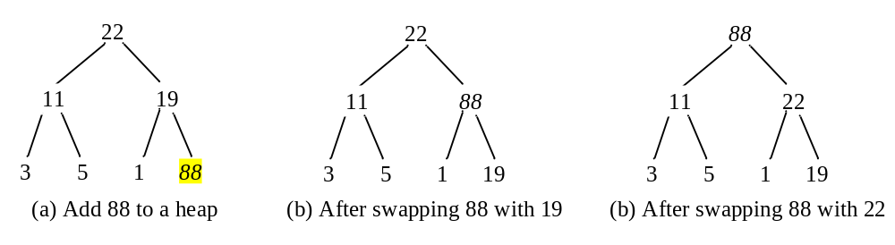
Rebuild the heap after adding a new node
Adding 88 to the heap

Slide 36
Removing the Root
After the root is removed, the tree must be rebuilt to maintain the heap property. The algorithm can be described as follows:
Move the last node to replace the root;
Let the root be the current node;
While (the current node has children and the current node is smaller than one of its children) {
Swap the current node with the larger of its children;
Now the current node is one level down;
}

Slide 37
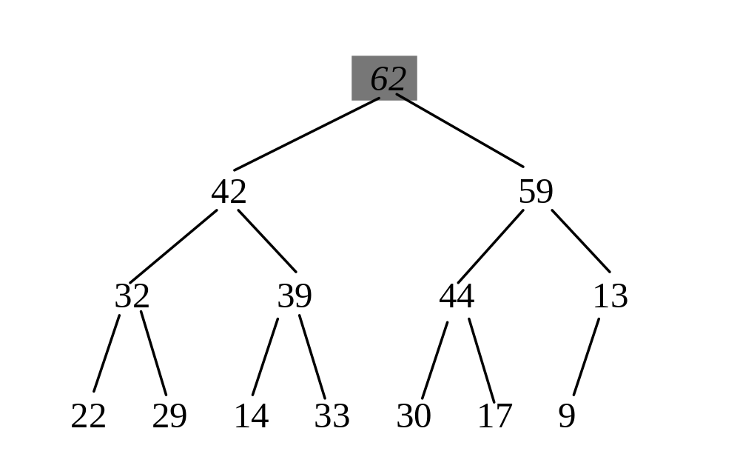
Removing the Root and Rebuild the Tree
Removing root 62 from the heap

Slide 38
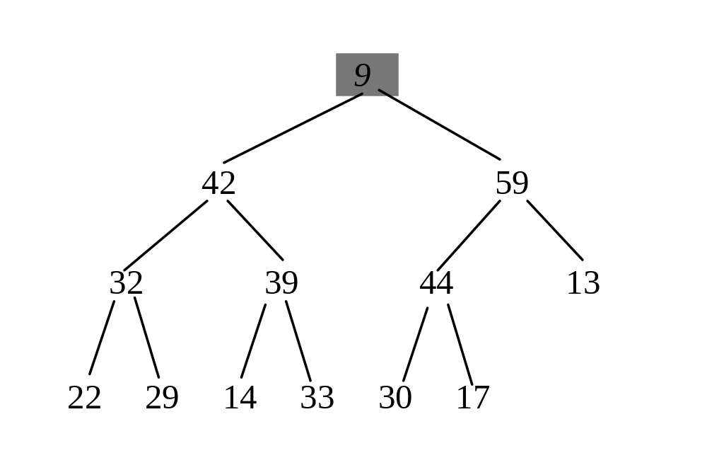
Removing the Root and Rebuild the Tree
Move 9 to root

Slide 39
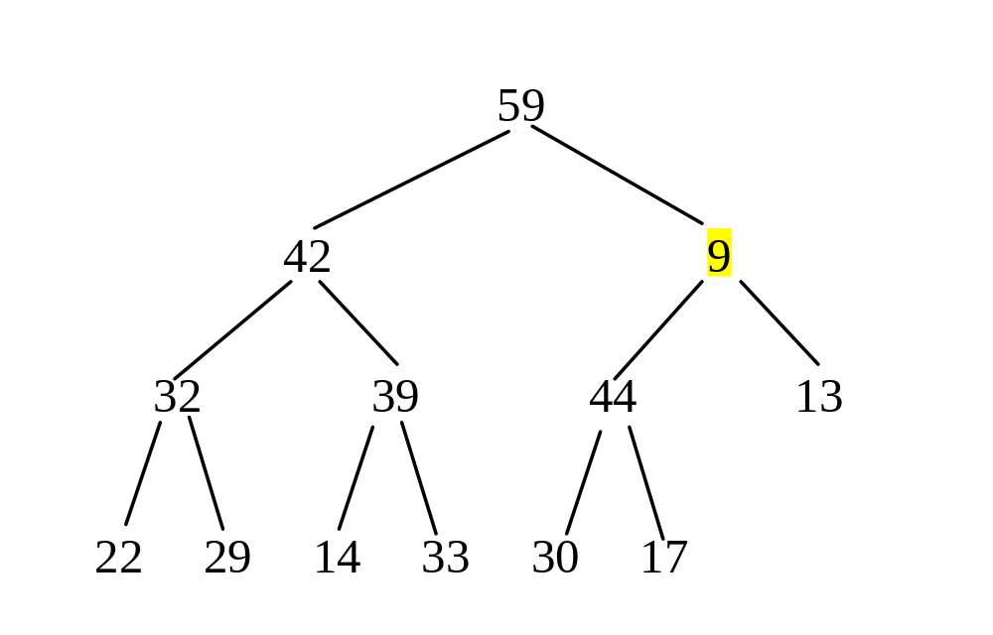
Removing the Root and Rebuild the Tree
Swap 9 with 59

Slide 40
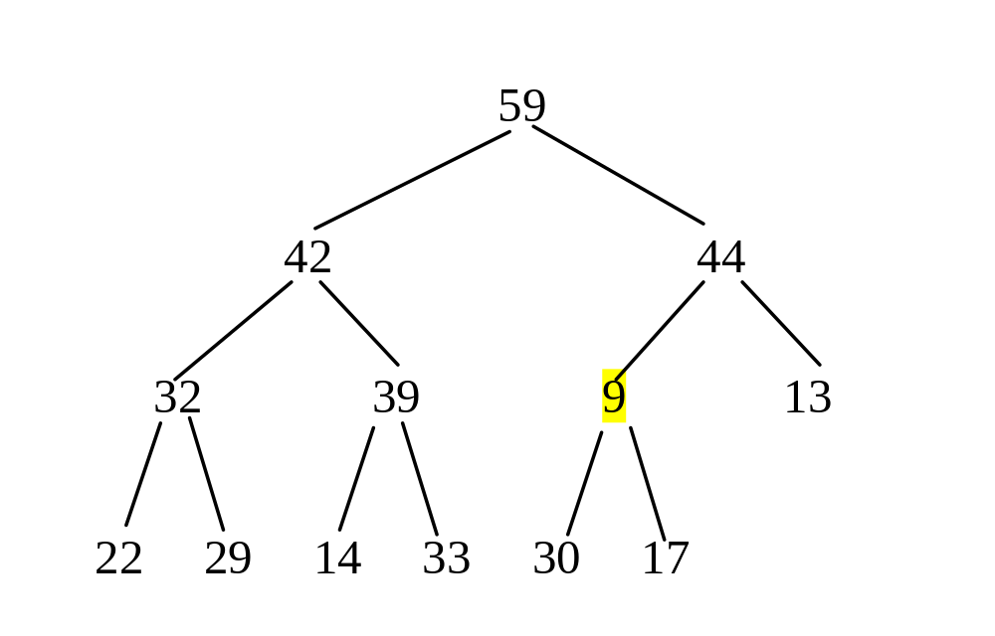
Removing the Root and Rebuild the Tree
Swap 9 with 44

Slide 41
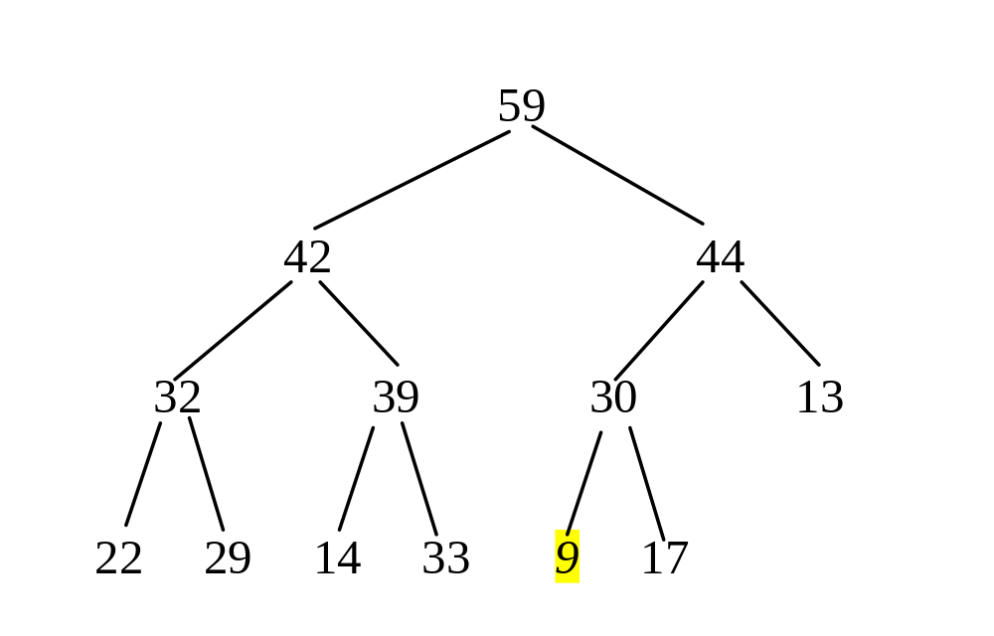
Removing the Root and Rebuild the Tree
Swap 9 with 30

Slide 42
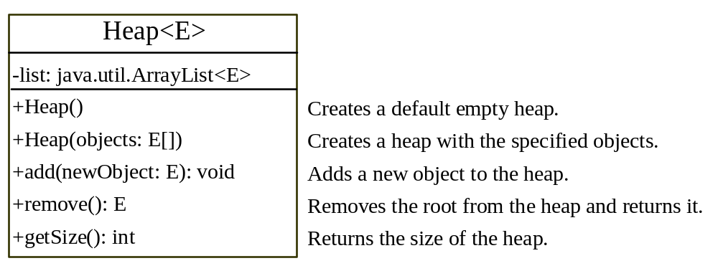
The Heap Class
Heap

Slide 43
Heap Sort
HeapSort
Run

Slide 44





Heap Sort Time
Let h denote the height for a heap of n elements. Since a heap is a complete binary tree, the first level has 1 node, the second level has 2 nodes, the kth level has 2^{(k-1)} nodes, the (h-1)th level has 2^{(h-2)} nodes, and the hth level has at least one node and at most 2^{(h-1)} nodes. Therefore,

Slide 45
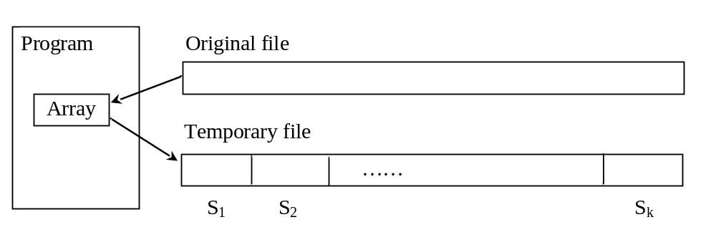
External Sort
All the sort algorithms discussed in the preceding sections assume that all data to be sorted is available at one time in internal memory such as an array. To sort data stored in an external file, you may first bring data to the memory, then sort it internally. However, if the file is too large, all data in the file cannot be brought to memory at one time.
CreateLargeFile
Run
SortLargeFile
Run

Slide 46
Phase I
Repeatedly bring data from the file to an array, sort the array using an internal sorting algorithm, and output the data from the array to a temporary file.

Slide 47
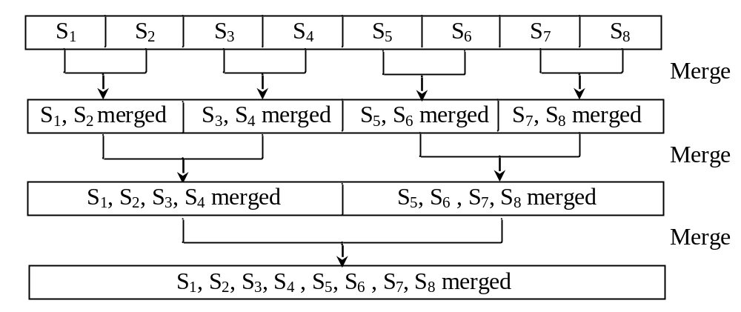
Phase II
Merge a pair of sorted segments (e.g., S1 with S2, S3 with S4, ..., and so on) into a larger sorted segment and save the new segment into a new temporary file. Continue the same process until one sorted segment results.

Slide 48
Implementing Phase II
Each merge step merges two sorted segments to form a new segment. The new segment doubles the number elements. So the number of segments is reduced by half after each merge step. A segment is too large to be brought to an array in memory. To implement a merge step, copy half number of segments from file f1.dat to a temporary file f2.dat. Then merge the first remaining segment in f1.dat with the first segment in f2.dat into a temporary file named f3.dat.

Slide 49
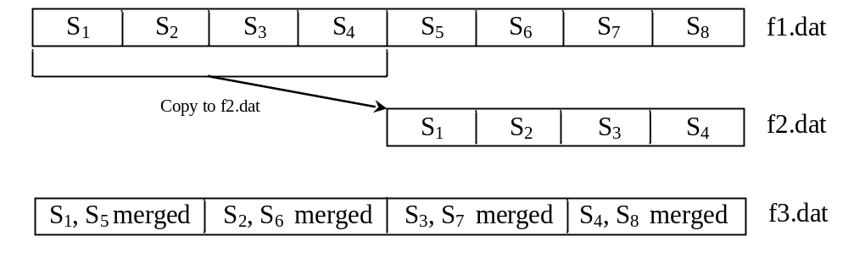
Implementing Phase II

